Slide 1

Order of Execution in Salesforce
with Interview Questions

Slide 2
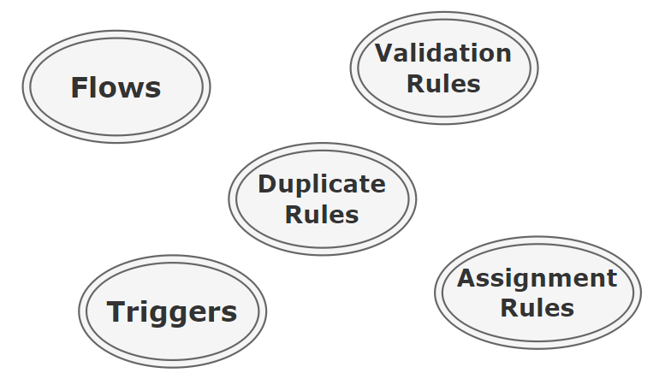
What is Order of Execution?
A step-by-step process that determines how different process / tools will get execute when we perform DML operation.
It ensures that everything is done in a specific order and nothing is missed.

Slide 3
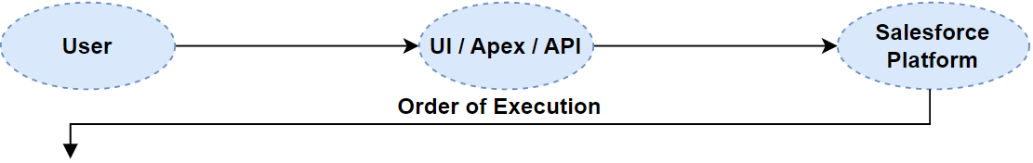
Order of Execution Steps?
1. Load Original Record from Database / Initialize Record
2. Load new values to record form request
Layout Specific Rules / Run System / Custom Validations
3. Execute Before Record Trigger Flow
4. Execute all Before Triggers
5. Run System / Custom Validations again
6. Execute Duplicate Rules
7. Save record to Database, Not commit
8. Execute all after triggers
9. Execute Assignment Rules
10. Execute Auto Response Rules
11. Execute Workflow Rules
Field Update => Run System Validation / Triggers Again

Slide 4
Order of Execution Steps?
12. Execute Escalation Rules
13. Execute Flow Automations
Processes / Flows launched by Processes/Workflow Rule
14. Execute After Record Trigger Flow
15. Executes Entitlement Rules
16. Perform roll-up summary calculations
Update rollup field in parent record
17. Rollup for grandparent if any field
18. Execute Criteria Based Sharing
19. Commit to Database
20. Execute Post Commit Logics
Sending mail / Enqueued Async Jobs / Async Flow

Slide 5
What will happen if we update value of same field in before trigger and in before flow, Which value will get saved?
Whatever is assigned in before trigger

Slide 6
Can we update field value in after record triggered flow for triggering record?
Yes

Slide 7
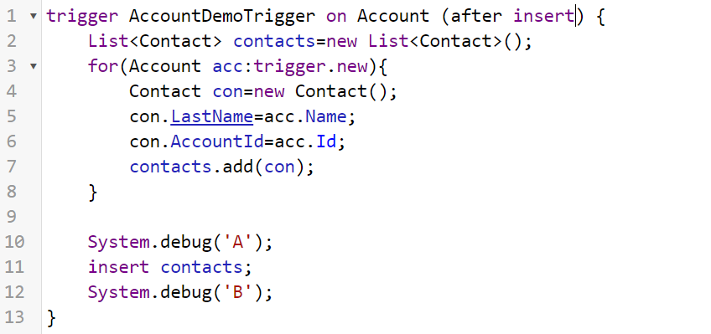
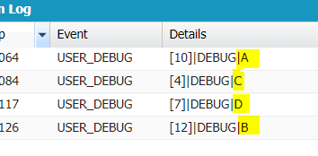
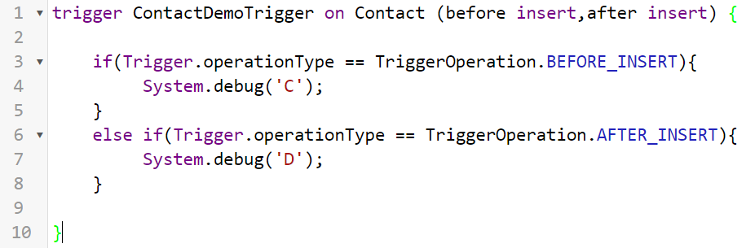
What will be the output of following code snippet?

Slide 8
Does changes to rollup summary fields value cause triggers to fire?
Yes

Slide 9
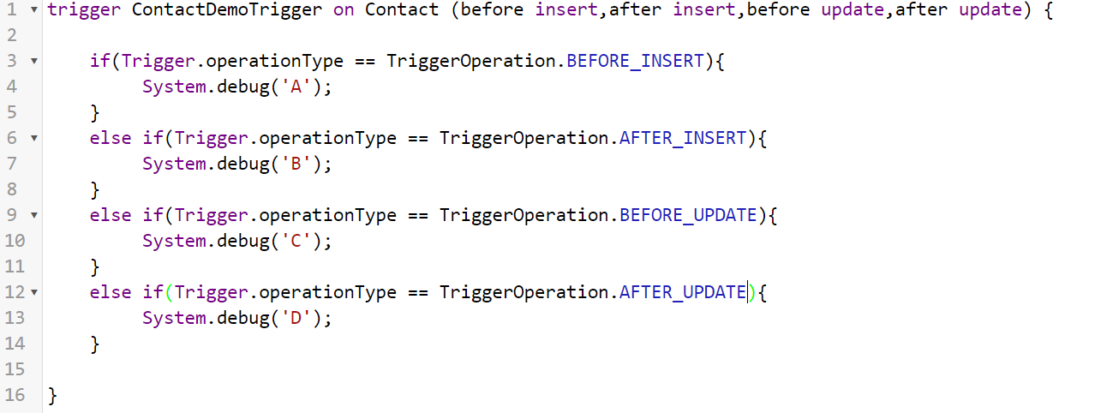
What will be trigger context if trigger get called again due to workflow rule field update?
Update

Slide 10
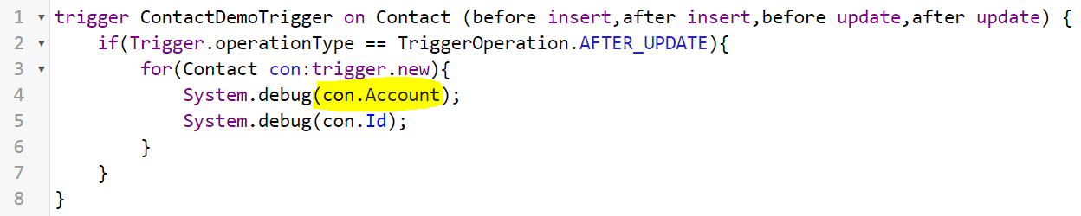
Can we access related records data in trigger context records?
No, have to use SOQL query to get related fields data.

Slide 11
What will happen with auto number if transaction gets rollback in salesforce?
Auto numbers also get removed and will not be reused.
Always generate unique

Slide 12
Thank You

